Slide 1



Grade 6
SB 79

Slide 2

How do people communicate
with the world ?
Communicate means share or exchange information , news and ideas.

Slide 3

How do you communicate with your friends?
Social media is a way to communicate with friends.

Slide 4
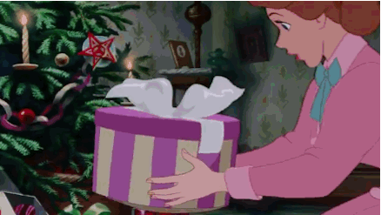

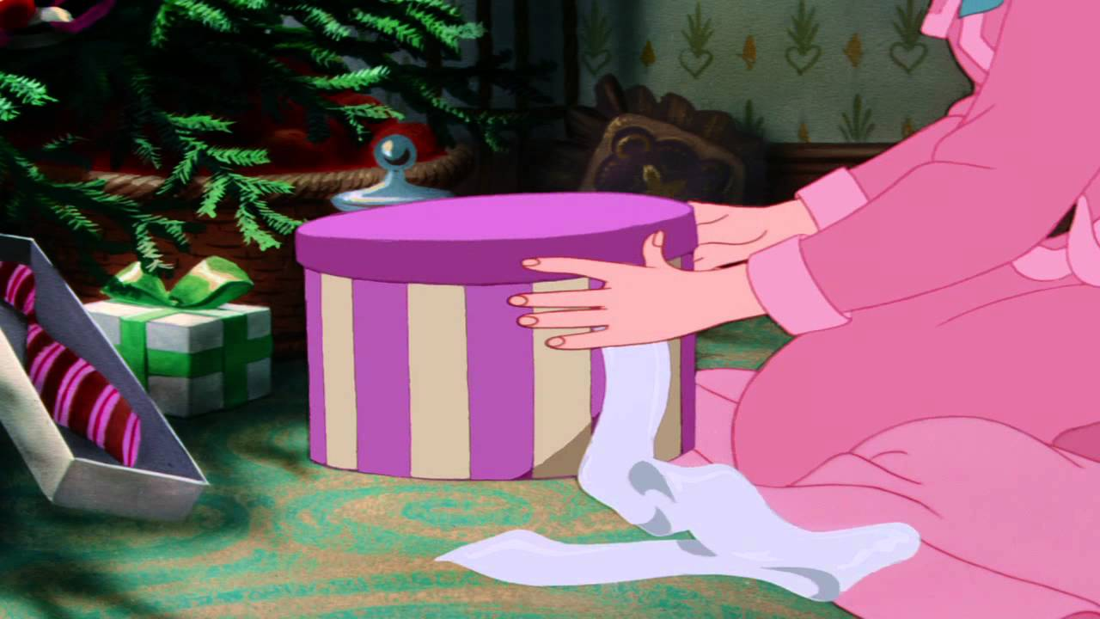
How do you feel when you receive a present?
Guess what is inside the present.

Slide 5

receive
Receive means get or be given

Slide 6

Student’s Book
Page 79

Slide 7

Look at these pictures And answer the following questions

Slide 8
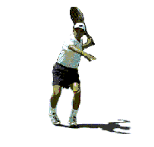
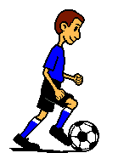
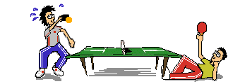
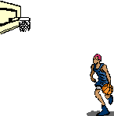
1- Which sports can you see here?

Slide 9
2- Which of these sports are you good at ?

Slide 10
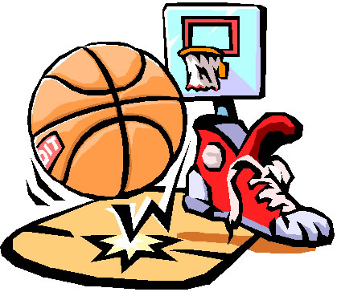
3- What do you need to play basketball?
basket
basketball
good boots

Slide 11
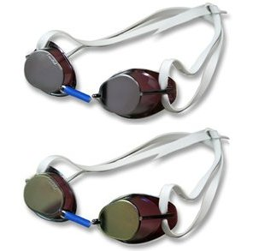
goggles
What do you need to swim?

Slide 12

goggles
You need goggles for swimming.

Slide 13
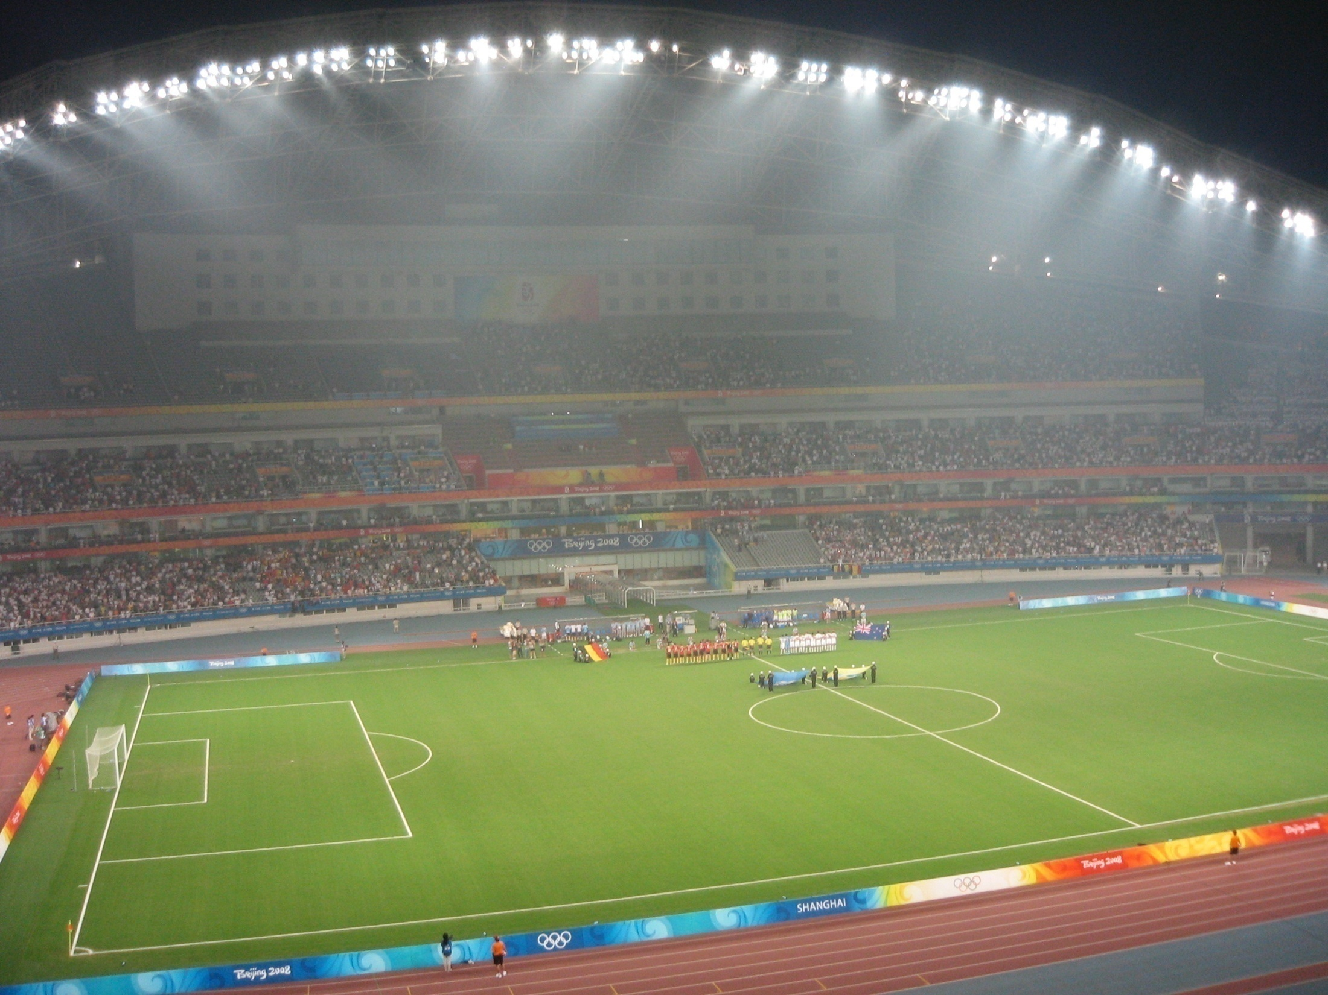
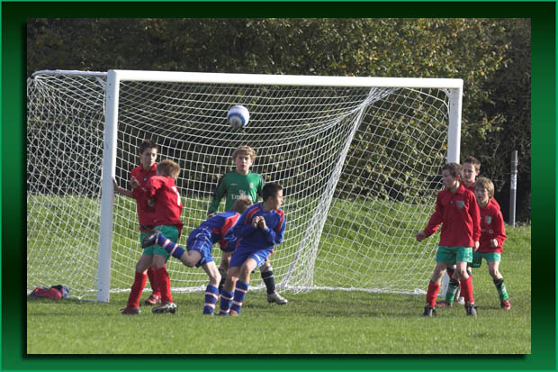
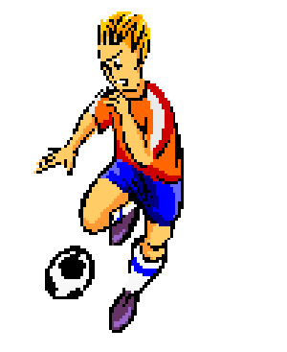

What do you need to play football?
goal
ball
good boots

Slide 14
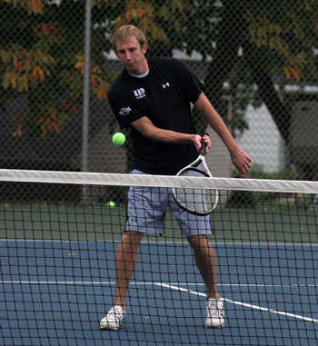
What do you need to play tennis?
small ball
racket
net

Slide 15
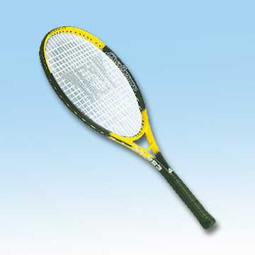
You need a racket to play tennis.

Slide 16

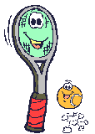
racket

Slide 17
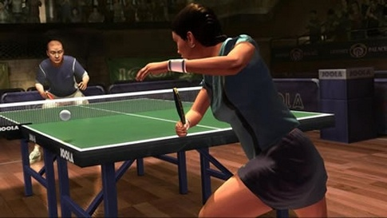
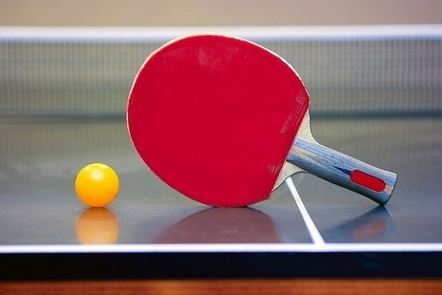
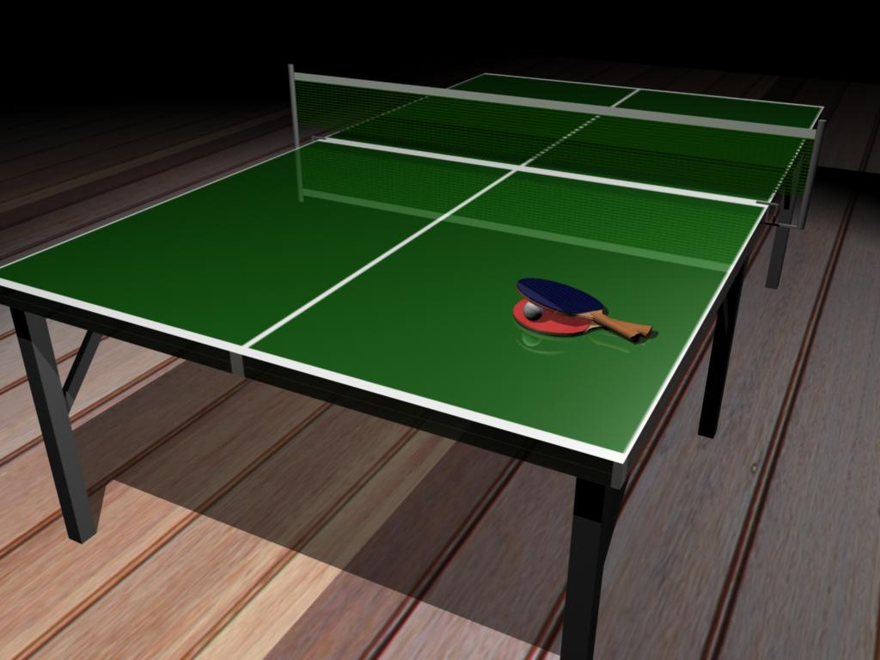

net
What do you need to play table tennis?
small ball
bat
table

Slide 18





Slide 19
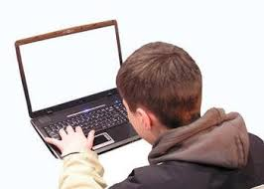
Ahmed is 12 years old. He is from Kuwait. He wrote an e-mail to his friend Peter who is from New Zealand to tell him about his favourite sports.
Let’s read his e-mail!
Dear Peter,
Good to hear from you!

Slide 20


When did Ahmed receive his friend’s e-mail?
I received your
e-mail yesterday.

